Slide 1
IEN 513
QUALITY MANAGEMENT IN SERVICE ORGANIZATIONS
BEST AND WORST CUSTOMER SERVICE COMPANIES IN THE US

Slide 2
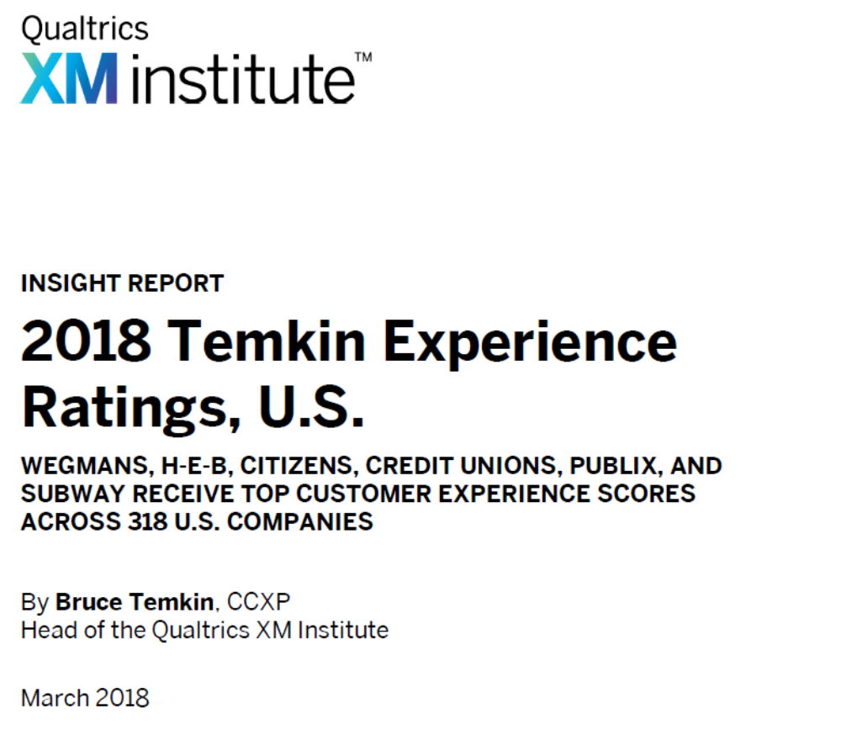
1 Data comes from the Temkin Group Q1 2018 Consumer Benchmark Survey – an online study of 10,000 U.S. consumers completed during January 2018. Survey respondents were representative of the U.S. Census based on quotas for age, income, ethnicity, and geographic region.

Slide 3
CALCULATING THE TEMKIN EXPERIENCE RATINGS
Here’s how we calculate the Temkin Experience Rating for each company
§ First, for each separate component (success, effort, and emotion), we look at the percentage of consumers who gave the company a high score (“6” or “7”) and the percentage who gave the company a low score (“1,” “2,” or “3”).
§ Second, within each individual component, we subtract the percentage of low scores from the percentage of high scores, which results in three separate ratings for each company, one for each component of the experience.
§ Finally, we average these three component scores for each company to generate that firm’s Temkin Experience Rating.

Slide 4
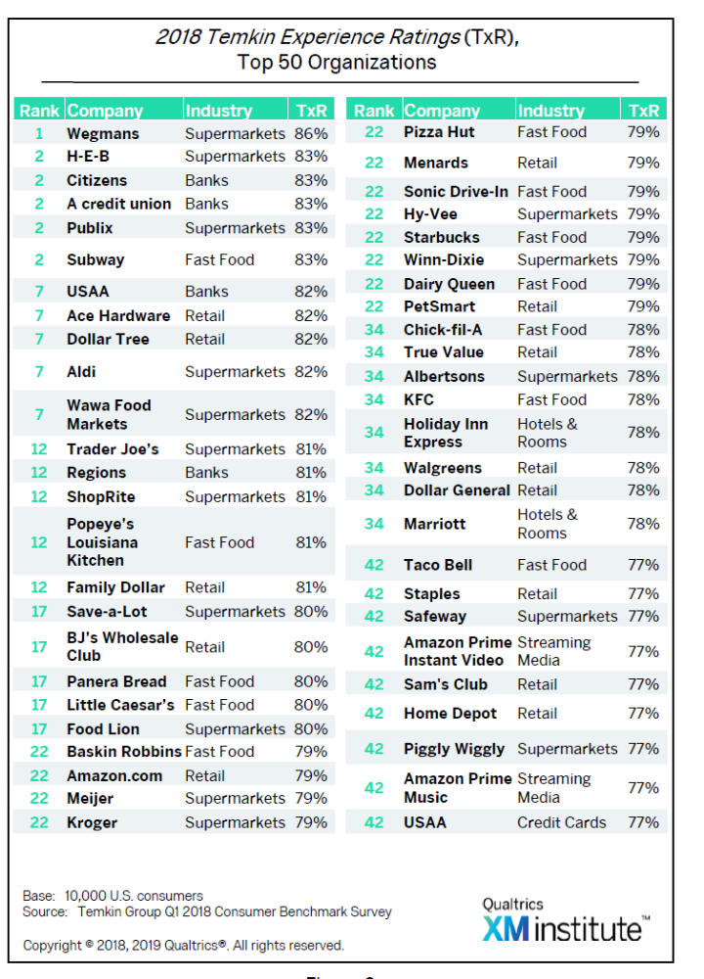
TOP 50

Slide 5
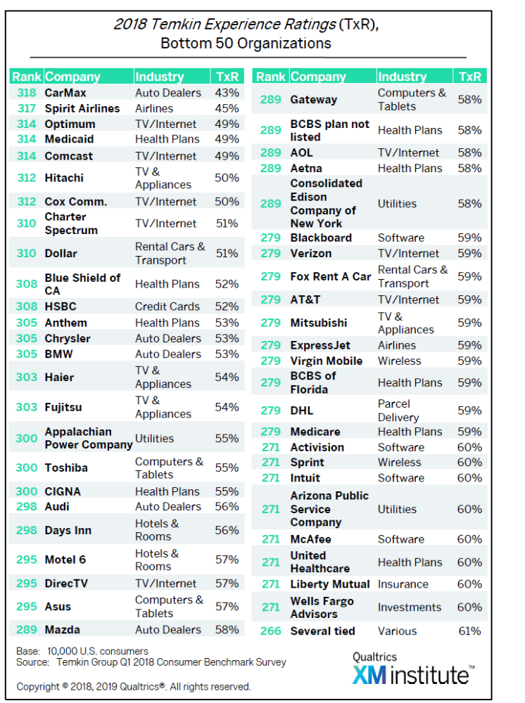
BOTTOM
50

Slide 6
The Temkin Experience Ratings is based on the three Components of an Experience
Success
Effort
Emotion

Slide 7
Success Experience Component
Thinking of your most recent interactions with each of these companies, to what degree were you able to accomplish what you wanted to do?
1 2 3 4 5 6 7
Completely Failed
Neutral
Completely Succeeded

Slide 8
Effort Experience Component
Thinking of your most recent interactions with each of these companies, how easy was it to interact with the company?
1 2 3 4 5 6 7
Very Difficult
Neutral
Very Easy

Slide 9
Emotion Experience Component
Thinking of your most recent interactions with each of these companies, how did you feel about those interactions?
1 2 3 4 5 6 7
Upset
Neutral
Delighted

Slide 10
TEMKIN METHODS
For each component, we take the percentage of consumers that gave a rating of 6 or 7 and subtract the percentage that gave a rating of 1, 2, or 3. ... The overall Temkin Experience Rating is an average of the three “net goodness” percentages.

Slide 11
SURVEY SAMPLE SIZE
To come up with its rankings, Temkin surveyed 10,000 U.S. consumers January 2014 for their experiences with 268 national and regional companies.
Temkin also ranked firms for Trust and Forgiveness (how likely consumers are to forgive a company if it delivers a bad experience).

Slide 12
Why Some Companies Score So Poorly
Temkin noted there are also good reasons why companies like Comcast, Highmark Blue Cross Blue Shield, Time Warner Cable, Coventry Health Care and Charter Communications get the lowest scores.
The groups at the bottom of Temkin’s rankings tend to cluster around three industries: TV, Internet and health plan providers. “These three industries have had a hard time focusing on customers,” said Temkin.

Slide 13
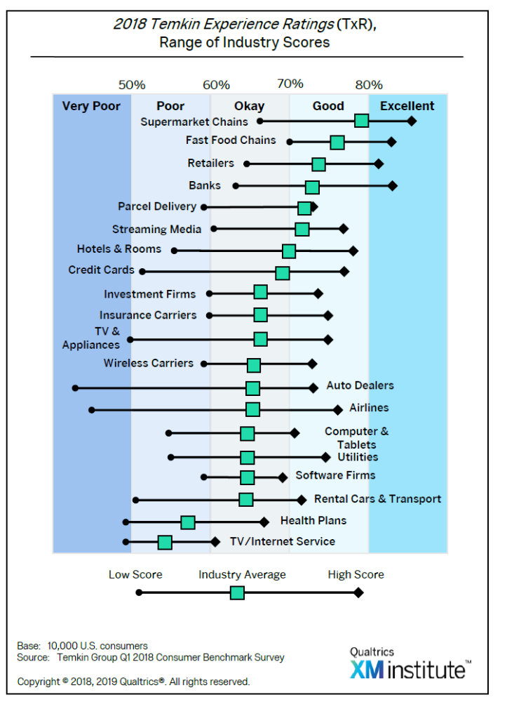

Slide 14
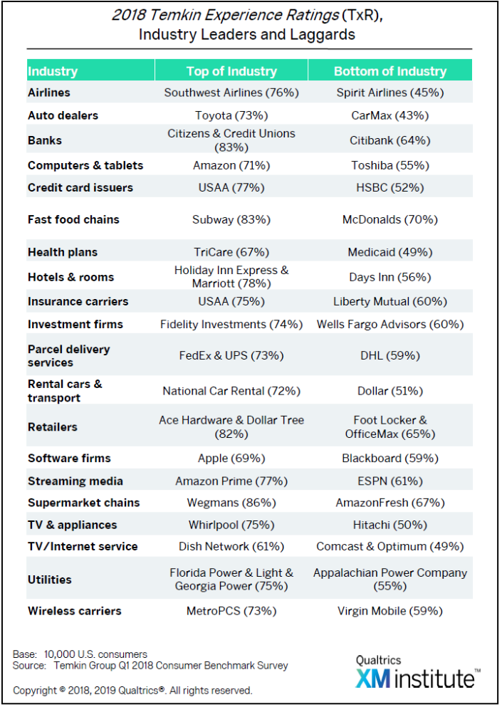
INDUSTRY LEADERS
INDUSTRY LAGGARDS

Slide 15
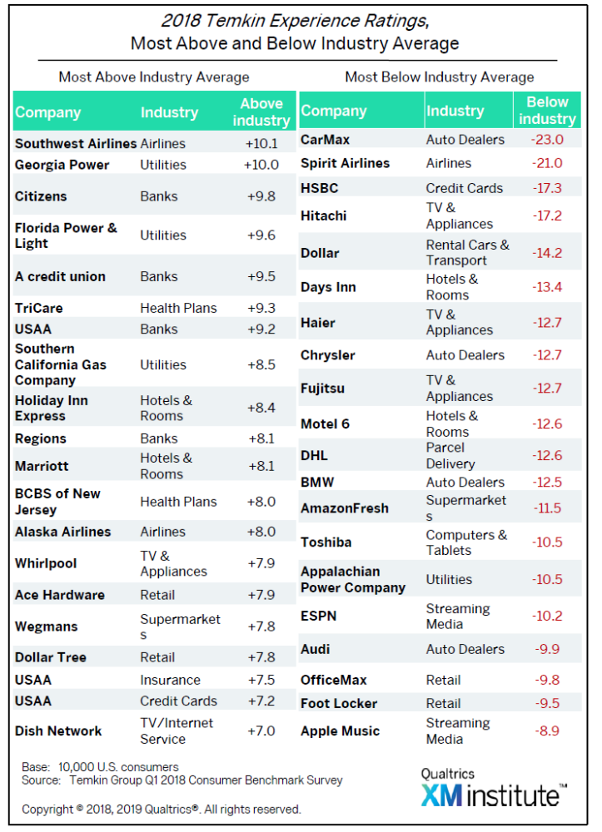
ABOVE INDUSTRY AVERAGE
BELOW INDUSTRY AVERAGE

Slide 16
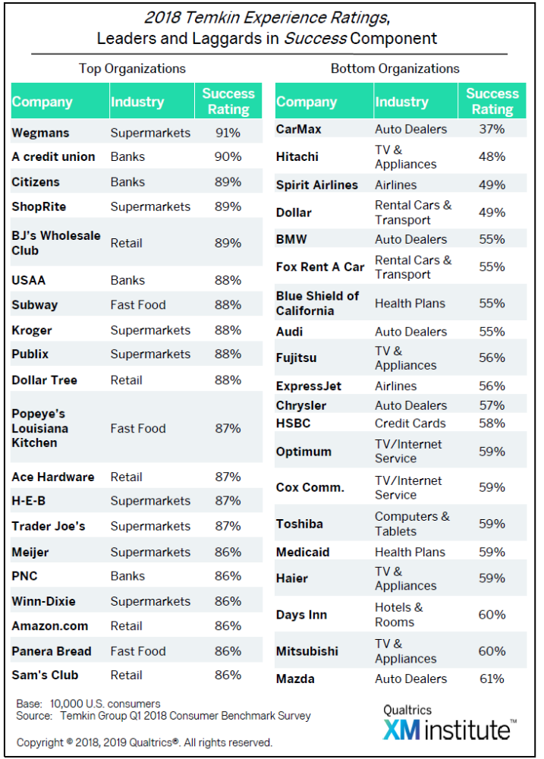
INDUSTRY LEADERS
INDUSTRY LAGGARDS

Slide 17
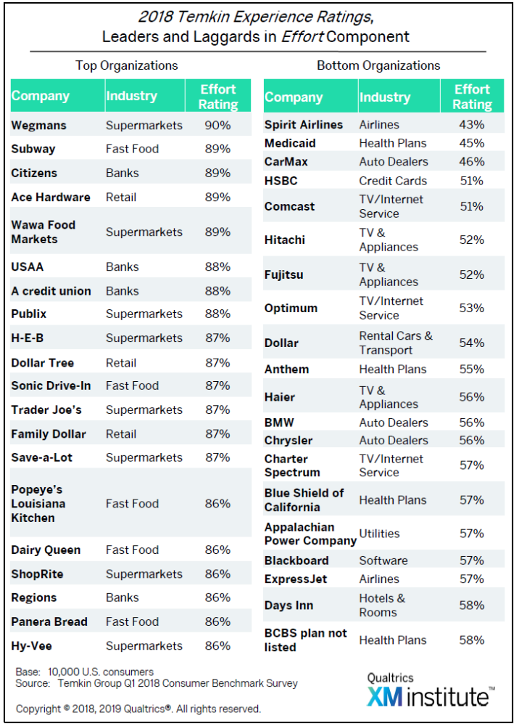
INDUSTRY LEADERS
INDUSTRY LAGGARDS

Slide 18
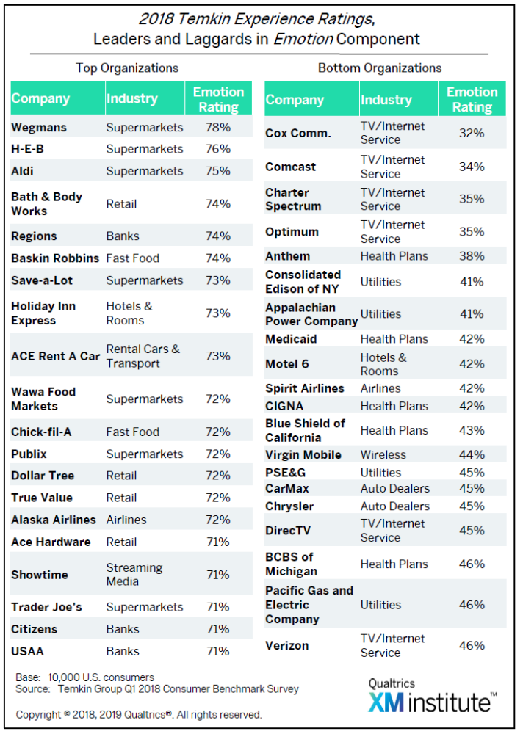
INDUSTRY LEADERS
INDUSTRY LAGGARDS

Slide 19
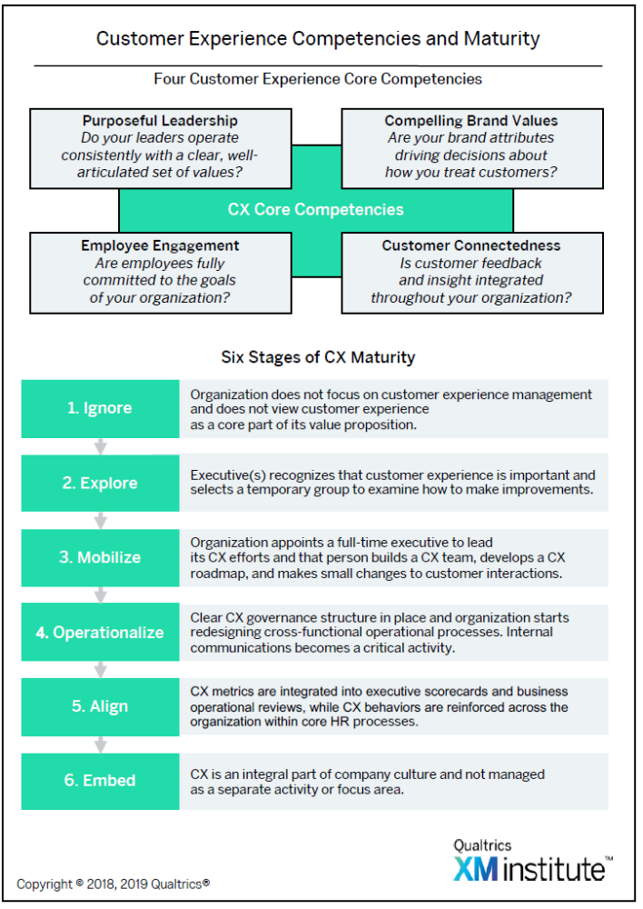

Slide 20
http://247wallst.com/
Customer Service Hall of Fame
By Michael B. Sauter, Thomas C. Frohlich and Samuel Stebbins July 23, 2015 9:49 am EDT

Slide 22
1. Amazon.com
Pct. ratings "excellent": 61.2%
For the sixth consecutive year, Amazon.com has topped the customer service Hall of Fame.
Less than 2% of survey respondents reported a poor experience, and 61.2% reported excellent customer service, by far the highest percentage among all companies reviewed.

Slide 23
2. Chick-fil-A
Pct. ratings "excellent": 48.9%
For the second year in a row, Chick-fil-A is the only fast-food chain to make the Customer Service Hall of Fame. And at the rate its customer service is improving it might take the top spot within a year or two. Of those surveyed, 48.9% rated the company's customer service as excellent.
The average store earns roughly $4.2 million each year — more than McDonald’s, Starbucks, or Subway — despite doing business only six days a week.

Slide 24
3. Apple
Pct. ratings "excellent": 45.4%
With 45.4% of customers surveyed reporting an excellent experience with the company, Apple is getting close to the top spot in the customer service Hall of Fame.
On a recent survey conducted by RBC Capital Markets, 83.4% of iPhone owners claim their next smartphone purchase would be an Apple product. Meanwhile, 64.2% of Samsung Galaxy owners claim the same about Samsung. In the fourth quarter of 2015, 30% of new iPhone purchases were by customers switching from Samsung to Apple.

Slide 25
4. Marriott
Pct. ratings "excellent": 44.7%
Roughly 45% of surveyed customers consider the customer service at Marriott to be excellent, the largest share of any hotel and the fourth largest of any company nationwide. On the same survey, respondents cite having a friendly and knowledgeable staff as the most important elements in quality customer service.
Marriott guests are also some of the most loyal in the hotel industry. The Marriott Rewards program has roughly 55 million members and more business travelers than any other rewards program.

Slide 26
5. Samsung Electronics
Pct. ratings "excellent": 43.2%
This year, 43.2% of survey respondents rated Samsung Electronics’ customer service as excellent. Samsung is a manufacturer of consumer electronics, and its customer satisfaction largely depends on the quality of its products as well as its support services.
While Samsung is still behind Apple in customer service, it does slightly better in product quality. The Samsung Galaxy Note5 ranks highest on American Customer Satisfaction Index list of top smartphones by customer satisfaction.

Slide 27

6. Sony
Pct. ratings “excellent”: 41.1%
More than two in five survey respondents consider Sony’s customer service to be excellent, the sixth largest share of any company.
As a manufacturer of consumer electronics, Sony not only needs to produce quality products, but also provide helpful support services. Sony has 534 customer support offices in the United States and receives roughly 1.8 million customer inquiries a year through either e-mail, phone, or chat services.

Slide 28

7. Google
Pct. ratings “excellent”: 40.9%
Google generates revenue primarily from online advertising. According to the company, Search, Android, Maps, Chrome, YouTube, Google Play, and Gmail have more than 1 billion active users each per month.
Google’s services, which are completely free for non-business users, are very popular and apparently also quite lucrative for its advertising clients. Google’s mobile operating system Android powers the vast majority of all new smartphones.

Slide 29
Customer Service Hall of Shame
By Michael B. Sauter, Samuel Stebbins and Thomas C. Frohlich July 23, 2015 9:47 am EDT

Slide 30
10. Wal-Mart
Pct. ratings “poor”: 13.8%
While customer satisfaction is not the same as approving of a company’s business practices, it may be that respondents let their views on Wal-Mart’s ethical practices affect their customer satisfaction rating.
Of those surveyed, 41.9% had an overall negative experience, while 13.8% rated their experience with the company as poor, the lowest possible rating, both very high figures.

Slide 31
9. Wells Fargo
Pct. ratings “poor”: 14.0% (credit card, banking)
Many Americans held the banking industry responsible for the recent financial crisis, and Wells Fargo’s reputation may still be suffering as a result.
Survey respondents rated Wells Fargo’s banking and credit card divisions equally: 14% of people reported a poor experience with each division. However, 32.2% of people had an excellent experience, relatively high compared with other poorly-rated companies.

Slide 32
8. T-Mobile
Pct. ratings “poor”: 14.7%
Wireless service provider T-Mobile’s customer service reputation took a serious hit in 2015, causing it to make the Hall of Shame for the first time.
In 2015, 14.7% of respondents rated the company’s service as poor. While roughly 63% of respondents rated the company’s service positively last year, the rate dropped to 58.3% in 2015.

Slide 33
7. Verizon Communications
Pct. ratings “poor”: 15.0%
Though Verizon may be steadily improving the speed and reliability of its network, the company’s customer service reputation is suffering.
The percentage of customers who rated their experience as poor jumped to 15% in 2015, putting the telecom giant at No. 7 on this year’s Hall of Shame worst customer service companies.

Slide 34
6. AOL
Pct. ratings “poor”: 16.1%
AOL has been on the Hall of Shame nearly every year since 24/7 Wall St. began covering this survey. It was ranked either the worst or second worst every year in the first four years but has improved somewhat since. Still, the media company took a step backward in 2015, moving from eighth to sixth place on the list.
While other companies on the Hall of Shame tend to share the list with several other companies in their industry, such as banks and cable service providers, AOL is the only primarily web-based company to make the list.

Slide 35
5. AT&T
Pct. ratings “poor”: 18.8% (mobile) 17.1% (U-verse)
Making the list for the third consecutive year, AT&T is yet another cellular service provider with waning customer satisfaction.
Nearly 19% of customers surveyed rated their experience with the company as poor, a slight jump from last year’s figure of 17.5%. This is bad news for the over 120 million consumers who choose AT&T.

Slide 36
4. Dish Network
Pct. ratings “poor”: 21.3%
Since 2010, Dish Network only missed making the Hall of Shame once, in 2011. The company fared particularly poorly in 2015.
As many as 46.1% of respondents had a negative experience with Dish’s customer service, the fourth worst of any company considered.

Slide 37
3. Bank of America
Pct. ratings “poor”: 21.4% (credit card, banking)
Ranked third on the Hall of Shame list, 21.4% of survey respondents rated their experience with the company as poor.
In the same survey, 38.9% of respondents, the largest share by a wide margin, said that fees were their biggest problem with the bank, either because the fees were too high, or occurred too frequently.
Bank of America is no different. The bank’s website lists five fees for checking accounts and another five for savings accounts. Thirteen other service fees include a $2.50 charge for using another bank’s ATM and a $35 overdraft penalty.

Slide 38
2. DirectTV
Pct. ratings “poor”: 21.5%
No stranger to the Hall of Shame list, DirectTV’s reputation took a further hit in 2015.
With 21.5% of respondents reporting a poor experience with the company, dissatisfaction has grown by more than a full percentage point from the previous year.

Slide 39
Comcast
Pct. ratings “poor”: 28.3%
Comcast had the worst customer service reviews of any company this year by a wide margin. At 28.3%, more respondents ranked their experience with the company as poor than any other company.
Furthermore, 54.4% of those surveyed claimed that their overall customer experience was negative, nearly 10 percentage points higher than the next worst rated company. This is Comcast’s seventh consecutive year on the Hall of Shame, and its first year at the top.

Slide 40
SURVEY METHODOLOGY
24/7 Wall St. commissioned Zogby Analytics to conduct an online national survey.
More than 1,500 randomly chosen respondents rated customer service at 151 of the best-known companies in the country.
Fifteen industries are represented in the study.
Respondents were asked to evaluate customer service quality as "excellent," "good," "fair," or "poor."
Of the 150 companies, 108 companies had at least 500 valid responses. Companies with fewer valid responses were not considered.
When a company with multiple divisions scored as one of the best or worst for customer satisfaction, the company was only listed once in our rank.
The 10 companies with the highest percentage of "poor" responses represent our Customer Service Hall of Shame.
Using the same methodology, the 10 with the highest percentage of "excellent" responses became our Customer Service Hall of Fame.
This is the second year 24/7 Wall St. has conducted this study.

Slide 41
PROJECT OPTION
HALL OF FAME
HALL OF SHAME
Amazon.com (59.4%)
Chick-fil-A (47%)
Apple (40%)
Marriott (39.2)
Kroger (38.6%)
FedEx (37.7%)
Trader Joe’s (37.7)
Sony (37%)
Samsung Electronics (36.9%)
UPS (36.7%)
Wal-Mart (13.8%)
Wells Fargo (14%)
T-Mobile (14.7%)
Verizon Comm. (15%)
AOL (16.1%)
AT&T (18.8% Mobile); (17.1% U-verse)
Dish Network (21.3%)
Bank of America (21.4%)
DirectTV (21.5%)
Comcast (28.3%)

Slide 42
PROJECT OPTION

Slide 43
SEMESTER PROJECT
Select an industry from any of the Project Option slides based on Temkin Experience Ratings.
For the selected industry, pick one industry leader and the corresponding laggard.
Do a comparative study on both companies (research) to answer the following questions:
  Give a brief history and background of each company, and the industry.
  What are the mission, vision and values of the companies?
  How do the companies define and measure quality
  What strategies are Critical to their Success? Failure?
  Summarize why one company is an industry leader and the other a laggard.

